Slide 1
Introduction to Computer Simulation of Physical Systems
(Lecture 4)
Simulating Particle Motion
PHYS 3061

Slide 2
Euler-Richardson algorithm:
a_{n} = F(y_{n}, v_{n}, t_{n})/m
v_{mid} = v_{n} +1/2 a_{n}Δt
y_{mid} = y_{n} +1/2 v_{n}Δt
a_{mid} = F(y_{mid}, v_{mid}, t +1/2 Δt)/m,
v_{n+1} = v_{n} + a_{mid}Δt
y_{n+1} = y_{n} + v_{mid}Δt

Slide 3
Although we need to do twice as many computations per time step,
the Euler-Richardson algorithm is much faster than the Euler algorithm
  because we can make the time step larger
  still obtain better accuracy than with either the Euler or Euler-Cromer algorithms
  What’s the fundamental idea of this algorithm?

Slide 4
Effects of Drag Resistance
A projectile on the surface of the Earth with no air friction,
  Including a plot of position versus time and an animation of a projectile moving through the air.

Slide 5
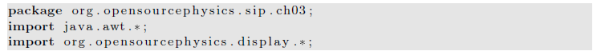
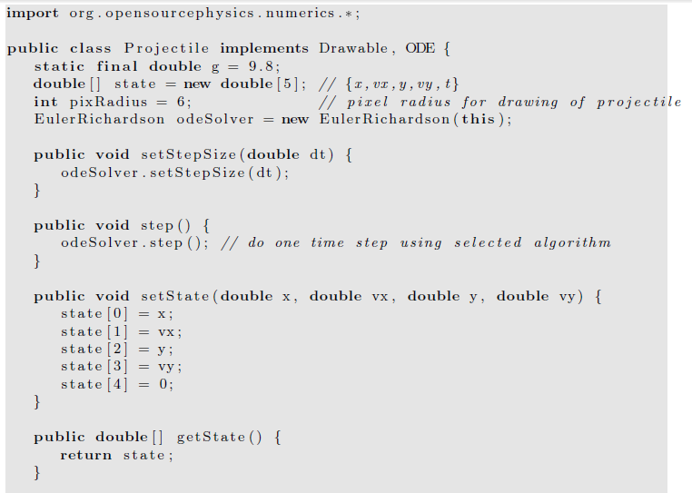

Slide 6
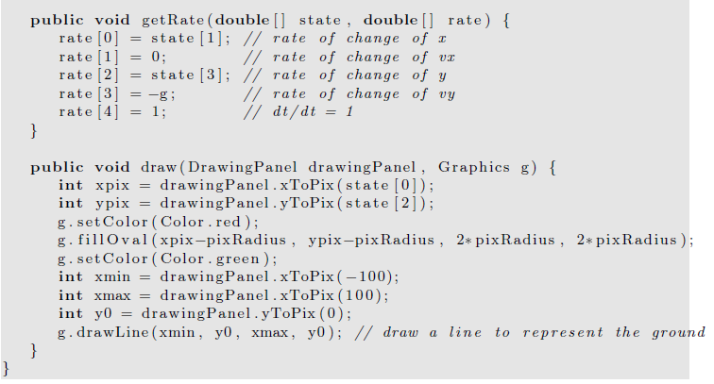

Slide 7
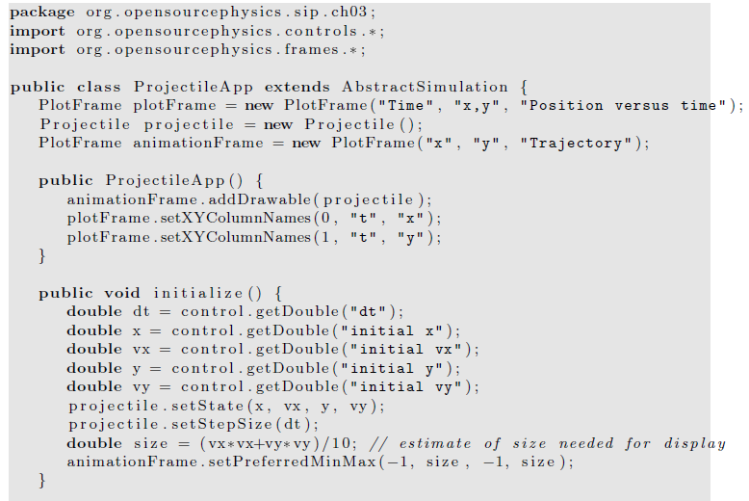

Slide 8
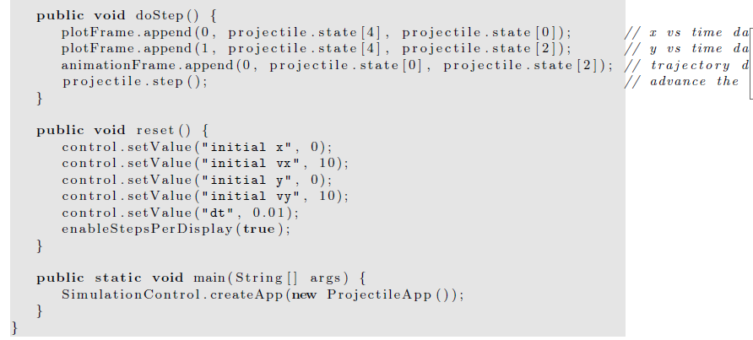

Slide 9
For particles near the Earth’s surface,
  an more important modification is to include the drag force due to air resistance.
  The direction of the drag force F_{d}(v) is opposite to the velocity of the particle
  For a falling body F_{d}(v) is upward
Hence, the total force F on the falling body can be expressed as
  F = -mg + F_{d}.
  What’s the final constant velocity?
  How can we measure the drag force?

Slide 10
The velocity dependence of F_{d}(v) is known theoretically
  in the limit of very low speeds for small objects.
In general, necessary to determine the velocity dependence of F_{d}(v) empirically over a limited range of velocities.
One way to obtain the form of F_{d}(v) is to measure y as a function of t
  and compute v(t) by calculating the numerical derivative of y(t).

Slide 11
Similarly we can use v(t) to compute a(t) numerically.
From this information it is possible in principle to find the acceleration as a function of v and to extract Fd(v).
  errors because the accuracy of the derivatives will be less than the accuracy of the measured position.
An alternative is to reverse the procedure
  assume an explicit form for the v dependence of Fd(v),
  use it to solve for y(t).
If the calculated values of y(t) are consistent with the experimental values of y(t),
  the assumed v dependence of Fd(v) is justified empirically.

Slide 12
The two common assumed forms of the velocity dependence of Fd(v) are
F_{1,d}(v) = C₁v,
F_{2,d}(v) = C₂v²,
the parameters C₁ and C₂ depend on the properties of the medium and the shape of the object.
  useful phenomenological expressions
    yield approximate results for F_{d}(v) over a limited range of v

Slide 13
Because F_{d}(v) increases as v increases,
  there is a limiting or terminal velocity (speed)
    the net force on a falling object is zero.
This terminal speed can be found by setting F_{d} = mg and is given by
v_{1,t} =mg/C₁ (linear drag)
v_{2,t} =(mg/C₂)^{1/2} (quadratic drag)

Slide 14
write F_{d} in the linear and quadratic cases as
F_{1,d} = C₁v_{1,t}( v / v_{1,t})= mgv/v_{1,t}
F_{2,d} = C₂v_{2,t}²( v/v_{2,t})²= mg( v/v_{2,t})²
the net force (per unit mass) on a falling object in the convenient forms
F₁ (v)/m= - g(1-v/v_{1,t})
F₂ (v)/m= -g(1- v²/v_{2,t}²)

Slide 15
Consider the fall of a pebble of mass m = 10⁻² kg.
To a good approximation, the drag force is proportional to v².
For a spherical pebble of radius 0.01 m, C₂ is found empirically to be approximately 10⁻² kg/m.
The terminal velocity to be about 30 m/s.

Slide 16
Two-Dimensional Trajectories
Consider an object of mass m
  whose initial velocity v₀ is directed at an angle θ₀ above the horizontal.
  The particle is subjected to gravitational and drag forces of magnitude mg and F_{d};
  the direction of the drag force is opposite to v.
Newton’s equations of motion for the x and y components of the motion can be written as
m dv_{x}/dt= -F_{d} cos θ
m dv_{y}/dt= -mg -F_{d} sin θ.

Slide 17
For example, let us maximize the range of a round steel ball of radius 4 cm.
A reasonable assumption for a steel ball of this size and typical speed is that F_{d} = C₂v².
Because v_{x} = v cos θ and v_{y} = v sin θ,
we can rewrite the equations in last page as
m dv_{x}/dt = -C₂vv_{x}
m dv_{y}/dt = -mg - C ₂vv_{y}.

Slide 18
Decay processes
The power of mathematics when applied to physics:
  seemingly unrelated problems frequently have the same mathematical formulation.
Hence, if we can solve one problem, we can solve other problems that might appear to be unrelated.
For example, the growth of bacteria, the cooling of a cup of hot water, the charging of a capacitor in a RC circuit, and nuclear decay all can be formulated in terms of equivalent differential equations.

Slide 19
Consider a large number of radioactive nuclei.
Although the number of nuclei is discrete,
  we often may treat this number as a continuous variable because the number of nuclei is very large.
In this case the law of radioactive decay
  the rate of decay is proportional to the number of nuclei.
Thus we can write
dN/dt= -λN,

Slide 20
dN/dt= -λN,
  where N is the number of nuclei and λ is the decay constant.
Of course, we do not need to use a computer to solve this decay equation,
  the analytical solution is N(t) = N₀e⁻ ^{λ t},
  where N₀ is the initial number of particles.
  The quantity λ has dimensions of inverse time.

Slide 21
Cooling of a cup of coffee
The nature of the energy transfer from the hot water in a cup of coffee to the surrounding air is complicated and in general involves the mechanisms of convection, radiation, evaporation, and conduction.
However, if the temperature difference between the water and its surroundings is not too large,
  the rate of change of the temperature of the water may be assumed to be proportional to the temperature difference.
We can formulate this statement more precisely in terms of a differential equation:
dT/dt= -r (T - T_{s})

Slide 22
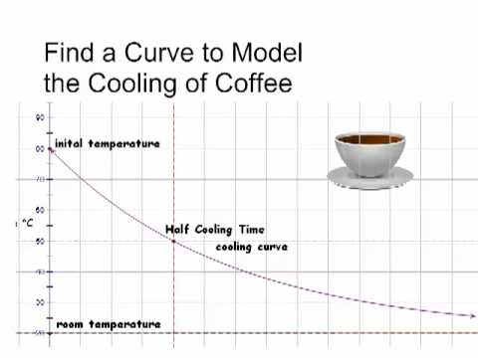
dT/dt= -r (T - T_{s})
  where T is the temperature of the water,
  T_{s} is the temperature of its surroundings, and r is the cooling constant.
  The minus sign implies that if T > T_{s}, the temperature of the water will decrease with time.
The value of the cooling constant r depends on the heat transfer mechanism,
  the contact area with the surroundings, and the thermal properties of the water.
The relation is sometimes known as Newton’s law of cooling, even though the relation is only approximate,
  and Newton did not express the rate of cooling in this form.

Slide 23
Numerical Integration of Newton’s Equation of Motion
several of the common finite difference methods for the solution of Newton’s equations of motion with continuous force functions.
The number and variety of algorithms currently in use is evidence that
  no single method is superior under all conditions.

Slide 24
Newton’s equations of motion in the form
dv/dt= a(t),
dx/dt= v(t)
The goal of finite difference methods is to determine the values of x_{n+1} and v_{n+1} at time t_{n+1} = t_{n} + Δt.
We already have seen that Δt must be chosen so that the integration method generates a stable solution.
If the system is conservative, Δt must be sufficiently small
  so that the total energy is conserved to the desired accuracy.

Slide 25
The nature of many of the integration algorithms can be understood by expanding
v_{n+1} = v(t_{n} + Δt) and x_{n+1} = x(t_{n} + Δt) in a Taylor series.
We write v_{n+1} = v_{n} + a_{n}Δt + O((Δt)²)
x_{n+1} = x_{n} + v_{n}Δt +1/2a_{n}(Δt)² + O((Δt)³)
The familiar Euler algorithm is equivalent to retaining the O(Δt) terms :
v_{n+1} = v_{n} + a_{n}Δt
x_{n+1} = x_{n} + v_{n}Δt. (Euler algorithm)

Slide 26
Because order Δt terms are retained, the local truncation error, the error in one time step, is order (Δt)².
The global error, the total error over the time of interest, due to the accumulation of errors from step to step is order Δt.
This estimate of the global error
  the number of steps into which the total time is divided is proportional to 1/Δt.
  Hence, the order of the global error is reduced by a factor of 1/Δt relative to the local error.
We say that an algorithm is nth order if its global error is order (Δt)^{n}.
The Euler algorithm is an example of a first-order algorithm.

Slide 27
The Euler algorithm is asymmetrical because it advances the solution by a time step Δt,
  But uses information about the derivative only at the beginning of the interval.
  We already have found that the accuracy of the Euler algorithm is limited and that frequently its solutions are not stable.
A simple modification yields solutions that are stable for oscillatory systems.
  Euler-Cromer
    Use v_{n+1}
  Midpoint algorithm
    use the mean velocity, ½ (v_{n}+v_{n+1})
    Second order accuracy!

Slide 28
Although the midpoint approximation yields exact results for constant acceleration, it usually does not yield much better results than the Euler algorithm.
In fact, both algorithms are equally poor, because the errors increase with each time step.

Slide 29
A higher order algorithm whose error is bounded is the half-step algorithm.
In this algorithm the average velocity during an interval is taken to be the velocity in the middle of the interval.
The half-step algorithm can be written as v_{n+1/2}= v_{n−1/2}+ a_{n}Δt,
x_{n+1} = x_{n} + v_{n+1/2}Δt. (half-step algorithm)

Slide 30
Note that the half-step algorithm is not self-starting,
  does not allow us to calculate v_{1/2}.
This problem can be overcome by adopting the Euler algorithm for the first half step:
V_{1/2}= v₀ +1/2a₀ Δt.
Because the half-step algorithm is stable, it is a common textbook algorithm!

Slide 31
The Euler-Richardson algorithm
x₁ ≈x(t + Δt) = x(t) + v(t)Δt +1/2a(t)(Δt)².
The notation x₁ implies that x(t+Δt) is related to x(t) by one time step.
We also may divide the step Δt into half steps and write the first half step, x(t + 1/2Δt), as
x(t +1/2Δt) ≈ x(t) + v(t)Δt/2+1/2a(t)(Δt/2)²

Slide 32
The second half step, x₂(t + Δt), may be written as
x₂(t + Δt) ≈ x(t +1/2Δt) + v(t +1/2Δt)Δt/2+1/2a(t +1/2Δt)(Δt/2)².

Slide 33
x₂(t + Δt) ≈x(t) +1/2[v(t) + v(t +1/2Δt)]Δt +1/2[a(t) + a(t +1/2 Δt)](1/2 Δt)²
Now a(t + 1/2Δt) ≈a(t) + 1/2a′(t)Δt.
Hence to order (Δt)², it becomes
x₂(t + Δt) ≈x(t) +1/2[v(t) + v(t +1/2Δt)]Δt +1/2[2a(t)](1/2 Δt)²

Slide 34
We can find an approximation that is accurate to order (Δt)³ by combining x1 and x2 so that the terms to order (Δt)² cancel.
The combination that works is 2x₂ - x₁, which gives the
Euler-Richardson result:
x_{er}(t + Δt) ≡2x₂(t+Δt)-x₁ (t+Δt)=x(t)+v(t+1/2Δt)]Δt +O (Δt)³
v_{er} ≡2v₂(t+Δt)-v₁ (t+Δt)=v(t)+a(t+1/2Δt)]Δt +O (Δt)³

Slide 35
A bonus of the Euler-Richardson algorithm is that the quantities |x₂ - x₁| and |v₂ - v₁| give an estimate for the error.
We can use these estimates to change the time step so that the error is always within some desired level of precision.

Slide 36
One of the most common drift-free higher order algorithms is commonly attributed to Verlet.
We write the Taylor series expansion for x_{n−1}
x_{n−1} = x_{n}- v_{n}Δt +1/2a_{n}(Δt)².

Slide 37
If we add the forward and reverse forms respectively, we obtain
x_{n+1} + x_{n−1} = 2x_{n} + a_{n}(Δt)² + O((Δt)⁴)
  Why can we do this?
or
x_{n+1} = 2x_{n}- x_{n−1} + a_{n}(Δt)². (leapfrog algorithm)
the subtraction of the Taylor series for x_{n+1} and x_{n−1} yields v_{n} = (x_{n+1} - x_{n−1})/2Δt (leapfrog algorithm)
What are the global error for x and v?

Slide 38
Note that the global error associated with the leapfrog algorithm is third-order for the position and second-order for the velocity.
However, the velocity plays no part in the integration of the equations of motion.
The leapfrog algorithm is also known as the explicit central difference algorithm.
Because this form of the leapfrog algorithm is not self-starting, another algorithm must be used to obtain the first few terms.

Slide 39
An additional problem is that the new velocity is found by computing the difference between two quantities of the same order of magnitude.
  Really no good!
Such an operation results in a loss of numerical precision and may give rise to roundoff errors.

Slide 40
A mathematically equivalent version of the leapfrog algorithm is given by
x_{n+1} = x_{n} + v_{n}Δt +1/2a_{n}(Δt)²
v_{n+1} = v_{n} +1/2 (a_{n+1} + a_{n})Δt. (velocity Verlet algorithm)
the velocity form of the Verlet algorithm, is self-starting and minimizes roundoff errors.

Slide 41
Another useful algorithm that avoids the roundoff errors of the leapfrog algorithm is due to Beeman and Schofield.
We write the Beeman algorithm in the form:
x_{n+1} = x_{n} + v_{n}Δt +1/6(4a_{n} - a_{n−1})(Δt)²
v_{n+1} = v_{n} +1/6(2a_{n+1} + 5a_{n} - a_{n−1})Δt. (Beeman algorithm)

Slide 42
The most common finite difference method for solving ordinary differential equations is the Runge-Kutta method.
Because Runge-Kutta algorithms are self-starting, they are frequently used to obtain the first few iterations for an algorithm that is not self-starting.
For details, read the textbook because it has been covered in PHYS2061.

Slide 43
The Dynamics of Many Particle
Systems
We simulate the dynamical behavior of many particle systems such as dense gases, liquids, and solids and observe their qualitative features.
Some of the basic ideas of equilibrium statistical mechanics and kinetic theory are introduced.

Slide 44
Introduction
With the knowledge of the laws of physics at the microscopic level,
  how to understand the behavior of gases, liquids, and solids and more complex systems?
  such as polymers and proteins?
For example, consider two cups of water prepared under similar conditions.
Each cup contains approximately 10²⁵ molecules which mutually interact and,
to a good approximation, move according to the laws of classical physics.

Slide 45
Although the intermolecular forces produce a complicated trajectory for each molecule, the observable properties of the water in each cup are indistinguishable and are easy to describe.
For example, the temperature of the water in each cup is independent of time even though the positions and velocities of the individual molecules are changing continually.

Slide 46
Although the intermolecular forces produce a complicated trajectory for each molecule,
  the observable properties of the water in each cup are indistinguishable and are easy to describe.
  For example, the temperature of the water in each cup is independent of time
    even though the positions and velocities of the individual molecules are changing continually.

Slide 47
One way to understand the behavior of a classical many particle system is to simulate the trajectory of each particle.
This approach, known as molecular dynamics, has been applied to various systems
  has given us much insight into a variety of systems in which the particles obey the laws of classical dynamics.

Slide 48
A calculation of the trajectories of many particles would not be very useful unless we know the right questions to ask.
Saving these trajectories would quickly fill up any storage medium, and we do not usually care about the trajectory of any particular particle.
  If God is a programmer, does he save all the history?
What are the useful quantities needed to describe these many particle systems?
What are the essential characteristics and regularities they exhibit?

Slide 49
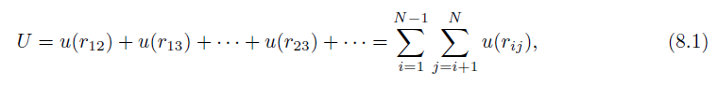
The Intermolecular Potential
We assume that the dynamics can be treated classically,
  the molecules are spherical
  and chemically inert
  and their internal structure can be ignored,
  and the interaction between any pair of particles depends only on the distance between them.
In this case the total potential energy U is a sum of two-particle interactions:

Slide 50
where u(r_{ij}) depends only on the magnitude of the distance r_{ij} between particles i and j.
The pairwise interaction form is appropriate for simple liquids such as liquid argon.
The form of u(r) for electrically neutral molecules can be constructed by a first principles quantum mechanical calculation.
Such a calculation is very difficult, and it usually is sufficient to choose a simple phenomenological form for u(r).
The most important features of u(r) are a strong repulsion for small r and a weak attraction at large r.

Slide 51
The repulsion for small r is a consequence of the Pauli exclusion principle.
  That is, the electron wave functions of two molecules must distort to avoid overlap, causing some of the electrons to be in different quantum states.
  What about other particles? Are there particles that can occupy the same state?
The net effect is an increase in kinetic energy and an effective repulsive interaction between the electrons,
  Known as core repulsion.
The dominant weak attraction at larger r is due to the mutual polarization of each molecule; the resultant attractive potential is called the van der Waals potential.

Slide 52
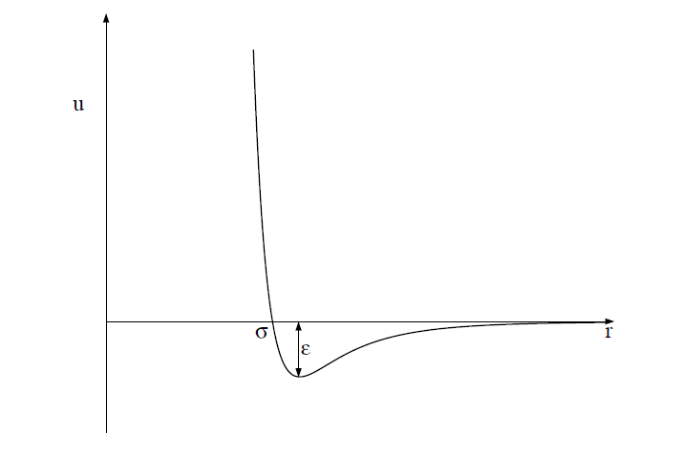
One of the most common phenomenological forms of u(r) is the Lennard-Jones potential:
u(r) = 4ϵ[(σ/r)¹²−(σ/r)⁶].

Slide 53
The r ⁻¹² form of the repulsive part of the interaction was chosen for convenience only and has no fundamental significance.
The attractive 1/r⁶ behavior at large r corresponds to the van der Waals interaction.
The Lennard-Jones potential is parameterized by a length σ and an energy ϵ.
Note that u(r) = 0 at r = σ, and that u(r) is close to zero for r > 2.5σ.
The parameter ϵ is the depth of the potential at the minimum of u(r); the minimum occurs at a separation r = 2^{1/6} σ.

Slide 54
Units
convenient to choose units
  the computed quantities are neither too small nor too large.
    What’s the problem of being too small or too large?
  Because the values of the distance and the energy associated with typical liquids are very small in SI units,
    What’s the typical value for distance and energy?
  we can choose the Lennard-Jones parameters σ and ϵ as the units of distance and energy, respectively.
  We can also choose the unit of mass to be the mass of one atom, m. We can express all other quantities in terms of σ, ϵ, and m.

Slide 55
For example, we can measure velocities in units of (ϵ/m)^{1/2},
and the time in units of σ(m/ϵ)^{1/2}.
The values of σ, ϵ, and m for argon are given in the next page.
If we use these values, we find that the unit of time is 2.17×10⁻¹² s.
The units of some of the other physical quantities of interest also are shown in next page.

Slide 56
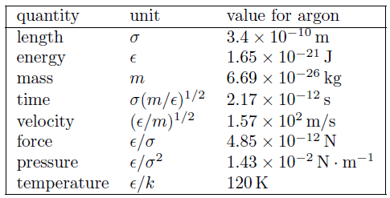
The system of units used in the molecular dynamics simulations of particles interacting via the Lennard-Jones potential. The numerical values of σ, ϵ, and m are for argon. The quantity k is Boltzmann’s constant and has the value k = 1.38 × 10⁻²³ J/K. The unit of pressure is for a two-dimensional system.

Slide 57
All program variables are in reduced units,
  for example, the time in our molecular dynamics program is expressed in units of σ(m/ϵ)^{1/2}.
  Suppose that we run our molecular dynamics program for 2000 time steps with a time step Δt = 0.01.
  The total time of our run is 2000 × 0.01 = 20 in reduced units or 4.34 × 10⁻¹¹ s for argon.

Slide 58
  The duration of a typical molecular dynamics simulation is in the range of 10–10⁴ in reduced units, corresponding to a duration of approximately 10⁻¹¹–10⁻⁸ s. The longest practical runs are the order of 10⁻⁶ s.

Slide 59
The Numerical Algorithm
we need to introduce a numerical method for computing the trajectory of each particle.
The criteria for a good numerical integration method include that
  it conserves the phase-space volume and be consistent with the known conservation laws, is time reversible, and is accurate for relatively large time steps to reduce the CPU time needed for the total time of the simulation.

Slide 60
We should use an algorithm for the relatively long time of interest in molecular dynamics simulations!
We adopt the commonly used second-order algorithm:
x_{n+1} = x_{n} + v_{n}Δt +1/2a_{n}(Δt)²
v_{n+1} = v_{n} +1/2(a_{n+1} + a_{n})Δt.

Slide 61
The new position is used to find the new acceleration a_{n+1},
  used together with a_{n} to obtain the new velocity v_{n+1}.
  The algorithm is known as the Verlet (or sometimes the velocity Verlet) algorithm.
  The sample code will use Verlet implementation of the ODESolver interface to implement the algorithm.
  Thus, the x, v_{x}, y, and v_{y} values for the ith particle will be stored in the state array at state[4*i], state[4*i+1], state[4*i+2], and state[4*i+3], respectively.
  In your own code, you can just implement Verlet by yourself with the help of global arrays of position, velocities, and forces along each directions.

